Slide 1
INTERVIEW A PROFESSIONAL
ASSIGNMENT
Part 1: Understanding the Hero’s Journey

Slide 2
The Importance of Storytelling
Storytelling illustrates for an employer who you are and how you have handled challenges and opportunities.
More important, storytelling helps you make sense of who you are. You gain perspective on yourself.

Slide 3
The Importance of Storytelling
THE HERO’S JOURNEY (HJ)
You will learn about the “Hero’s Journey” (HJ) framework.
Then you will work at seeing yourself through the HJ framework.
THIS IS PART 1 OF THE INTERVIEW A PROFESSIONAL ASSIGNMENT

Slide 4
The Importance of Storytelling
PART 1 IS ABOUT YOU!

Slide 5
The Importance of Storytelling
PART 1 IS ABOUT YOU!
Identify YOUR LIFE’S grand narratives, hero’s journeys, monomyths
Learn about your own hero’s journey and how to share it to connect with others
Learn to get others to share their stories so you can:
  understand their experiences
  demonstrate empathy
  identify solutions to problems
  give voice to those who are unable to speak up

Slide 6
The Importance of Storytelling
Practice networking and forging genuine professional connections
Craft a written interview, which provides the opportunity to recognize its unique “rhetorical features,” a process that will hone your ability to analyze communication at the micro level
Get Familiar with the HJ Framework First by Practicing on Yourself

Slide 7
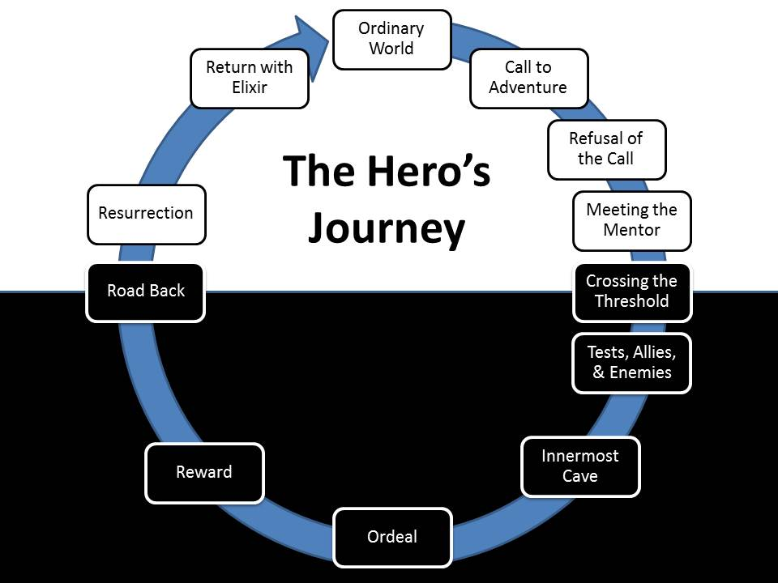
What is your grand narrative?

Slide 8
What is your grand narrative?
What is your 1) “grand narrative, 2) your “hero’s journey”?
These two constructs describe your own life experiences as something miraculous and mythic. In fact when you understand your life as mythic, you provide yourself the gift of adventure and your work here in this span of human history takes on meaning. Even work that may not on the surface appear overly “heroic” on the surface can require herculean efforts and courage.

Slide 9
Critical Student Preparation Details
The term hero’s journey was popularized by Joseph Campbell, a highly-regarded anthropologist who studied myths and stories around this world, discovering that the HJ is a universal framework for experiencing life.
This video, “The Hero's Journey According to Joseph Campbell” explains how his work relates to us all.
This video, “The Hero's Journey in 5 Minutes,” explains why the hero’s journey appears in our favorite stories.
Here is a one ordinary person’s heroic journey to buck the expectations of his parents, his teachers, his coaches—and create his own story. Use this last video as an example as you uncover your own grand narrative.

Slide 10
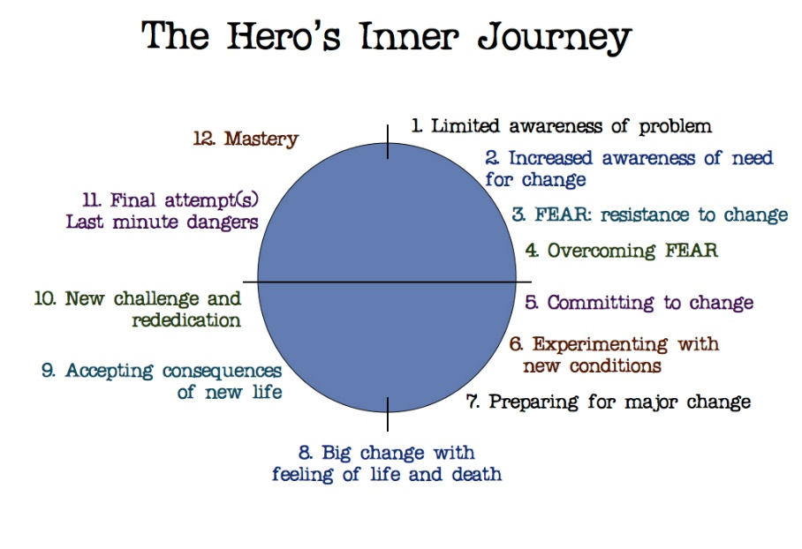
The Hero’s Inner Journey
The concept of the heroic journey is equally applicable to teams or individuals. However, for now, consider only the story of yourself. In the graphic to the right, you will notice that each stage of the hero’s inner journey is characterized by emotional responses. Understanding these phases in yourself and in others can help you see where you are at in relation to this particular story at that time in your life.

Slide 11
The Hero’s Inner Journey
Step 1. Think of a specific time in your life that changed you fundamentally (perhaps it’s right now?).
Perhaps you have lost a parent or sibling? Perhaps you moved to another country and are on your own? Perhaps you encountered professional or personal rejection? Perhaps you had to face a health issue? Or admit you weren’t cut out for something? These are the situations that have called you to respond – sometimes reluctantly, somethings boldly— and have changed you fundamentally.

Slide 12
The Hero’s Inner Journey
Free write, focusing specifically on this first step, about what happened, writing as rapidly as you can, without critiquing what you say or how you say it—this will help you “loosen up” to more fully consider it as part of your own heroic journey.
Do not skip this step.

Slide 13
The Hero’s Inner Journey
Step 2. Now map your story onto the stages in the hero’ journey you see to the right.
Draw a circle and label the phases from figure 1. Map your experience onto the sequence above. You can also use sticky notes for each stage if you want.

Slide 14
The Hero’s Inner Journey
Step 3. Now add the labels from the STAR approach (listed below), and notice the similarities between both frameworks.
STAR:
Situation
Tension
Action
Result

Slide 15
The Hero’s Inner Journey
Lastly, remember that all the best stories have dramatic tension, whether they are responses you give during a behavioral interview or stories you share with professional colleagues or friends.
To ratchet up the drama, make sure you say what was at stake at the “Tension” phase: What did you stand to lose or gain? Winning the championship? Getting the job done? Your self-esteem? Your dad’s respect? Who else could be impacted and how? Be specific here and add “pathos” (the emotional stakes).

Slide 16
The Hero’s Inner Journey
What if Your Journey Isn’t Complete?
We are all only human, and we “fail” sometimes by refusing to acknowledge the knock on the door, the call to adventure and sometimes because the obstacles are so formidable. If you think this describes you, then this particular journey is not yet complete (any idea how it will turn out?).
But there were other journeys in the past that transformed you: you accepted the challenge and emerged from it back into your ordinary life with an elixir or treasure, whether it was wisdom, mastery, the big win, the loot, the job, the girl, an acceptance to college, or passing 8th grade. Identify one of these and write about it.

Slide 17
What is expected of me for this assignment?
Review this powerpoint and read the word document associated with Part 1 of the assignment. The cover the same information, but do both. Reviewing the information 2 to 3 times will give you an advantage.
Watch all three of the video clips on SLIDE 9 of this powerpoint presentation. They are enormously helpful in creating clarity and direction for Part 1 and Part 2 of this assignment.
Free write a document based on the instructions of this powerpoint that is at least 2, preferably 3 pages long. Do your best on grammar and good writing technique, but for this assignment, I am more interested in hearing the bases and elements of your story and seeing how they connect to YOUR BIG PICTURE.

Slide 18
Final Perspective on Part 1 – Listen Up!
To do an effective job on Part 2 of the assignment, you must do a good job of Part 1 that relates to you.
Some assignments in college and the academic world may be busy work and seem to have limited application to your life. THIS IS NOT ONE OF THOSE ASSIGNMENTS.

Slide 19
Final Perspective on Part 1 – Listen Up!
This is your life, and this is how you communicate and convey the most important elements of your life to others in an effort to persuade them that you are worth the “relationship investment.”
Finally, remember, as we have discussed in class; that while communication skills are vital in all areas of your life, you are also investing in college and yourself so that jobs and opportunities will chase you all your life rather than you having to chase them for the rest of your life. This assignment aligns perfectly with that thought, and that is why it is worthy of your very best effort. And, that goes for Part 1 and Part 2.

